Slide 1
Leveraging Machine Learning Models for Climate Data Interpretation and Forecasting
Edwin Peraza
Maxwell Lebda
Cade Duncan

Slide 2
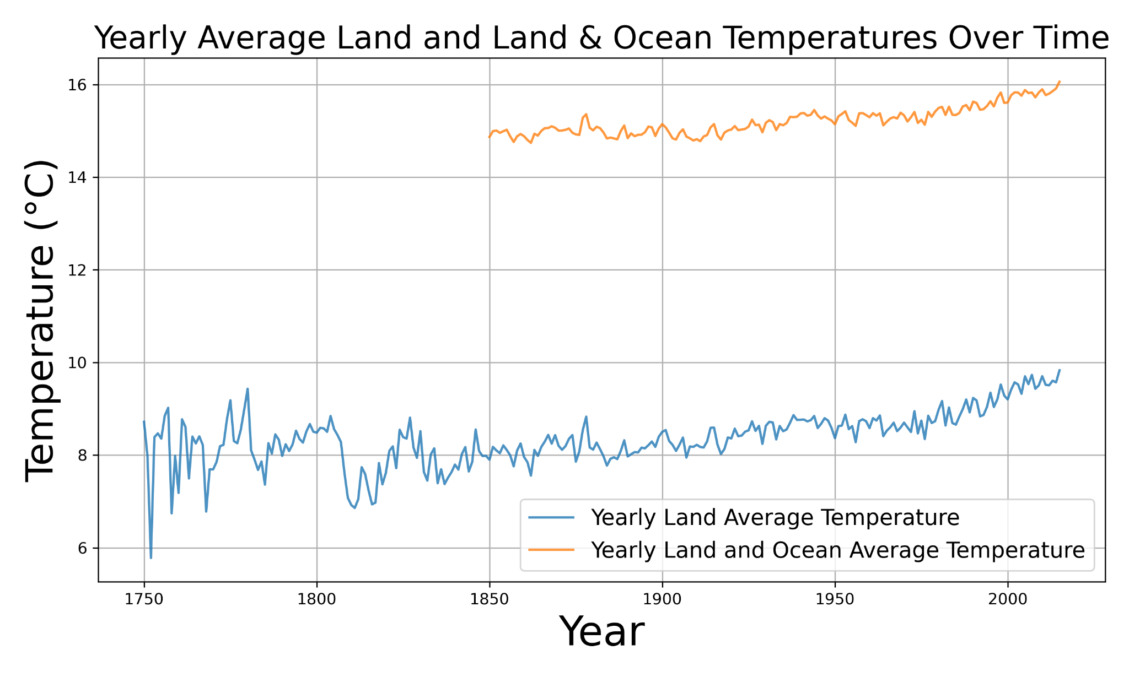
Introduction
Climate change impacts ecosystems, agriculture, and society.
Predicting temperature trends is critical for mitigation and adaptation strategies.
Objective Use machine learning models to analyze historical temperature data and forecast future trends.

Slide 3
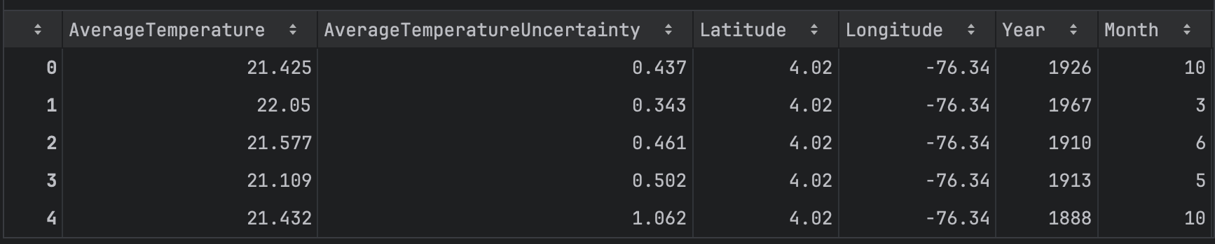
Dataset and features
Dataset: Berkeley Earth Surface Temperature data.
Features:
Target Variable: AverageTemperature
Temporal: Date (Year, Month, Day)
Spatial: Latitude, Longitude
Excluded: City and Country (to avoid redundancy)
Preprocessing:
Remove data points without AverageTemperature
Remove data where the year is earlier than 1870
Split date feature into day, month and year
Results:
Before: 239177 data points
After: 171125 data points
Notes:
Data from earlier years contains many missing or incomplete values, which could reduce the reliability of our model.

Slide 4

Machine Learning Models
Linear Regression
Random Forest
SVM (Support Vector Machine)
KNN (K-Nearest Neighbours)

Slide 5
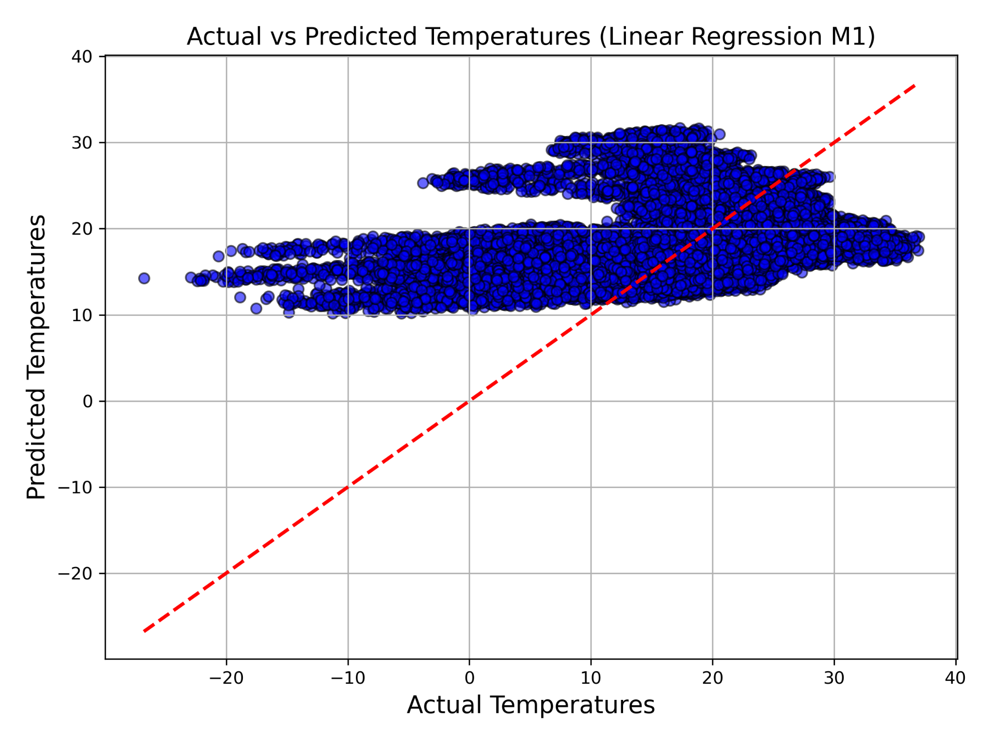
Linear Regression
Random train-test split (80/20)
Why?
Baseline model
Simplicity and interpretability
Experiment configuration:
Tested with final features and reduced features
Results:
Performed poorly due to inability to model non-linear relationships
Provided a guidance for future experiments
Notes:
We initially thought that the data was going to have a linear relationship
Poor performance allow us to realize Non linear relationship

Slide 6
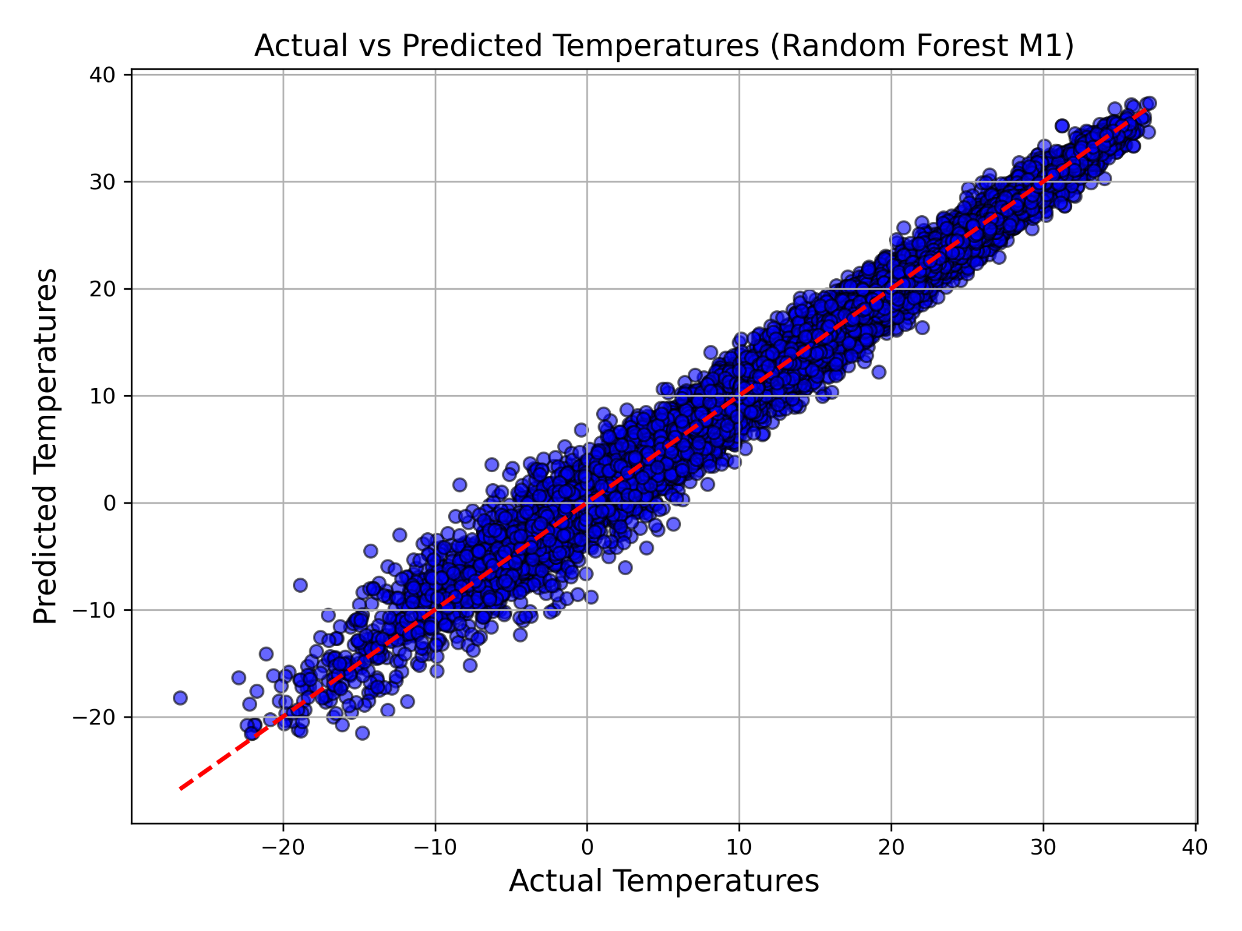
Random Forest
Random train-test split (80/20)
Why?
Captures non-linear relationship
Robust Against Overfitting
Experiment configuration:
With and without country encoding
Results:
Best R2 Score: 0.985694
Performance almost unchanged with encoded country variable
Notes:
Handles non linear functions and overfitting
M1 random forest performed the best
Country variable did not drastically change model

Slide 7
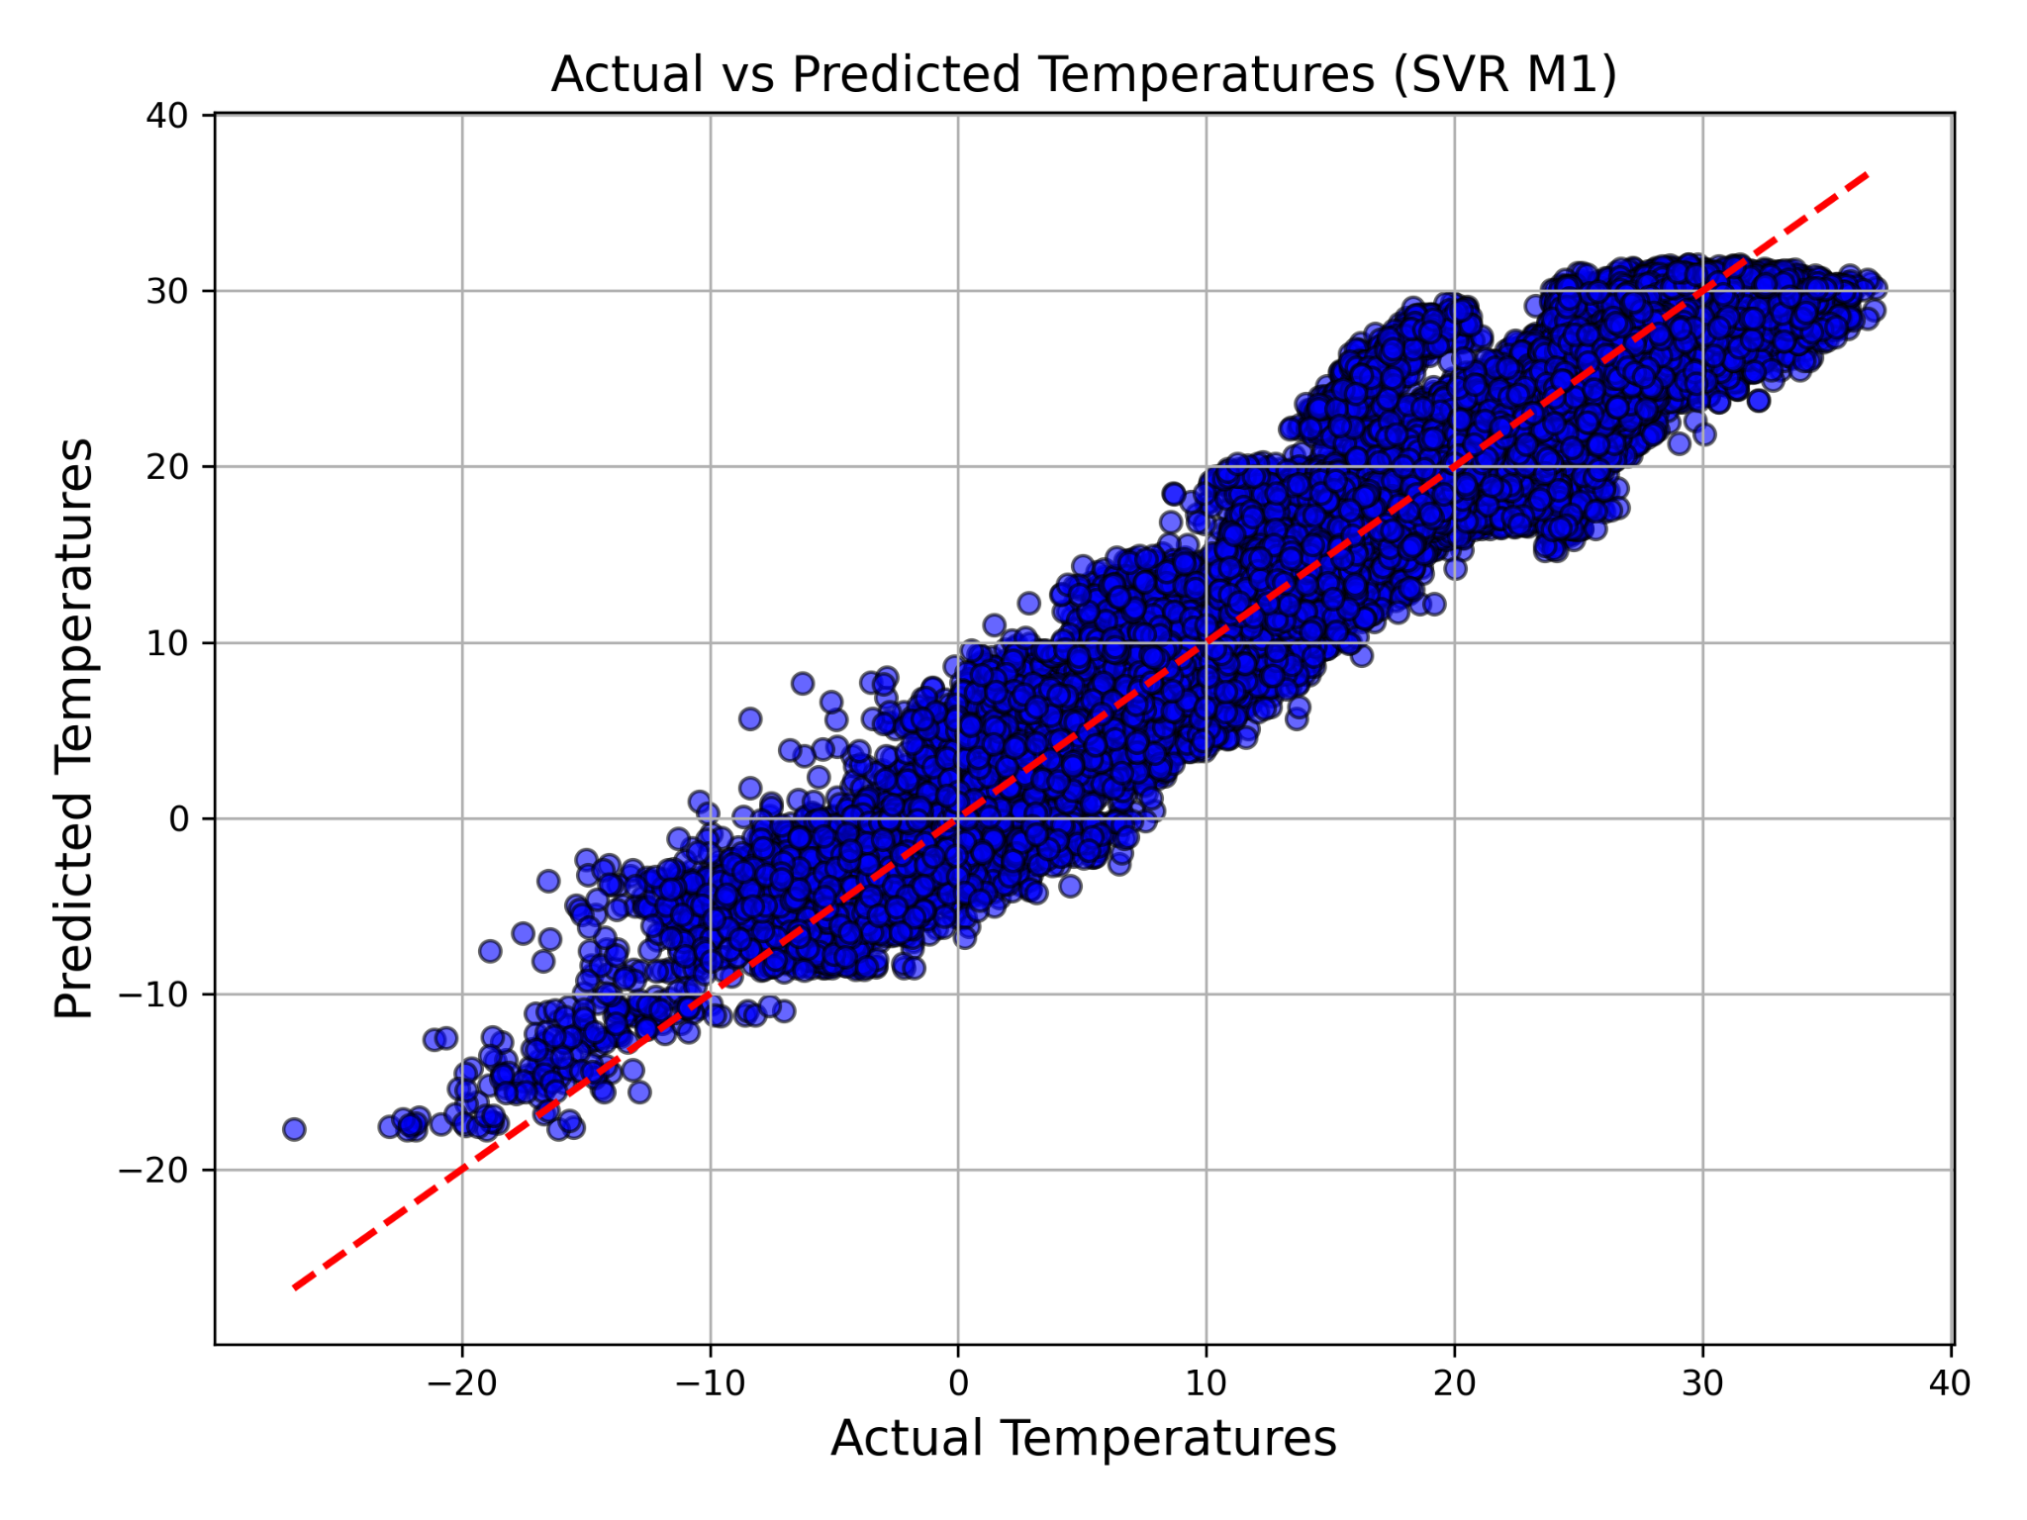
SVM
Random train-test split (80/20)
Why?
Handles non-linear patterns effectively
Robust to outliers
Experiment configuration:
Kernels tested: Linear, Polynomial, RBF
Results:
Polynomial and Linear kernel performed poorly
RBF kernel had one of the highest R2 Score: 0.9179
Slower training and prediction times compared to other models
Notes:
Used SVM because good at non linear patterns
Since linear regression performed poorly Not good with large datasets such as ours
RBF had the best preformance

Slide 8
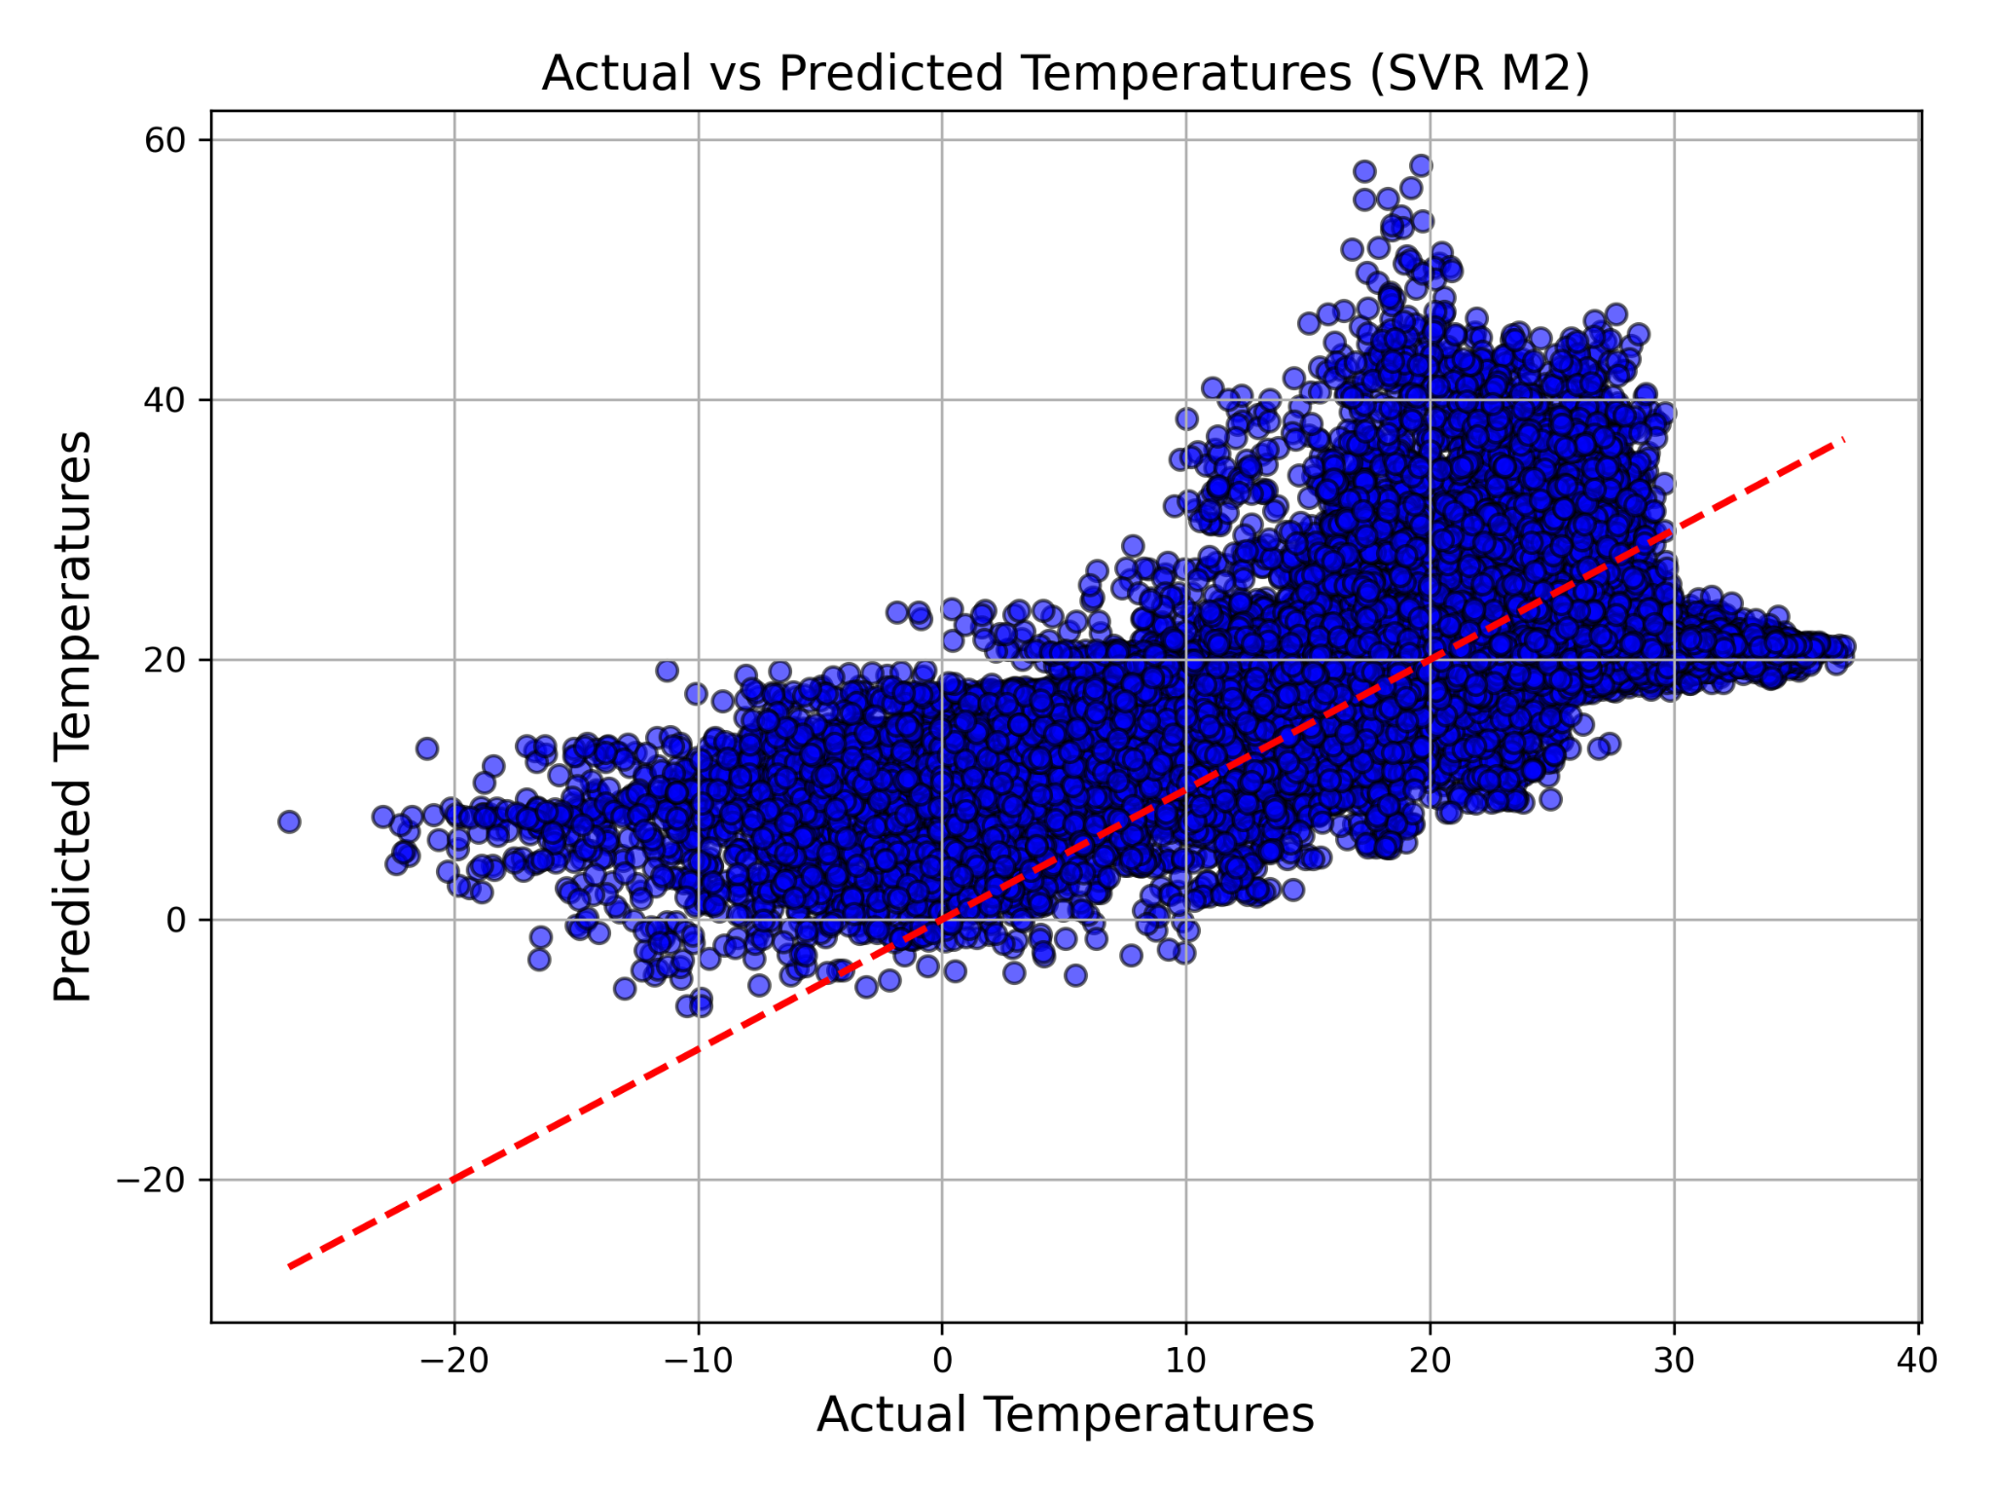
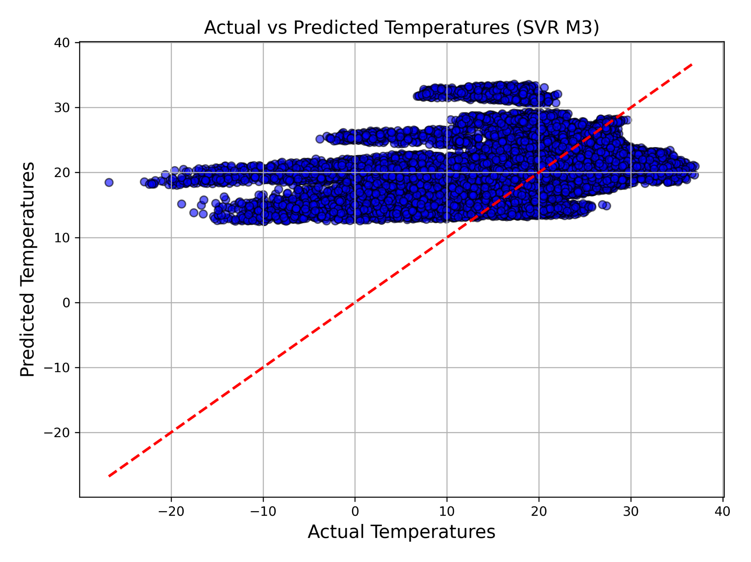
Comparison of SVM
Radial Basis Function (RBF)
Polynomial
Linear
Notes:
RBF preformed the best Linear performed the worst as expected based on linear regression

Slide 9
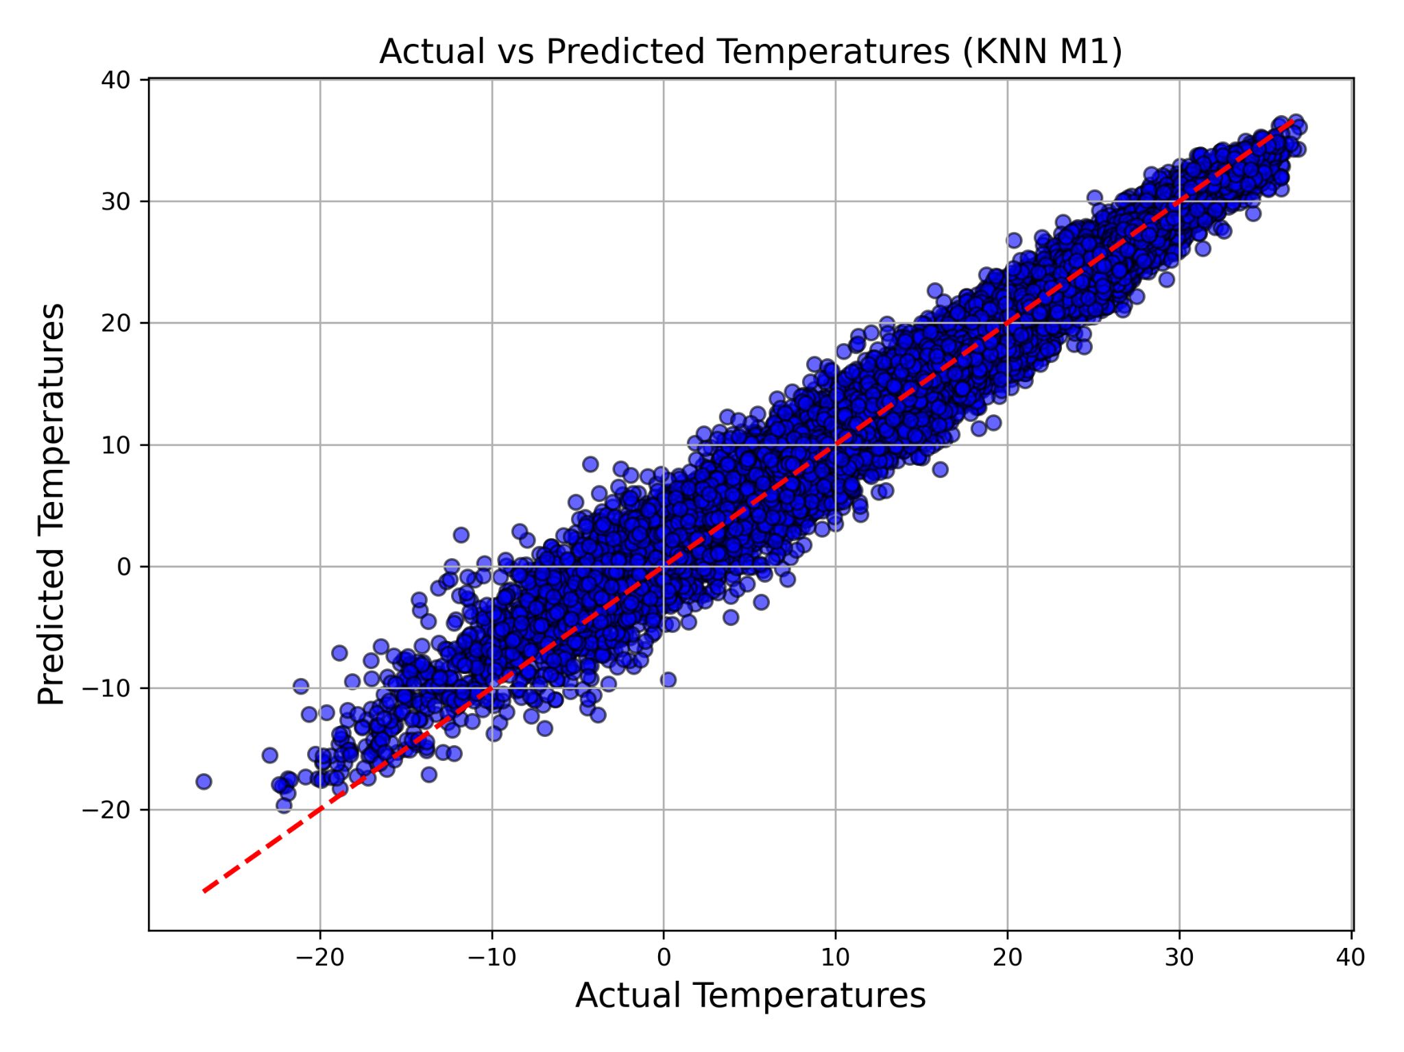
KNN
Random train-test split (80/20)
Why?
Simplicity of implementation
Effective for capturing local, spatial and temporal patterns
Experiment configuration:
Tested reduced feature set
Optimal k = 5
Results:
Performed poorly on reduced features
Second highest R2 Score: 0.970539
Notes:
Overall good performance Simple / effective Model 1 (full features) preformed better than Model 2 (less features)

Slide 10
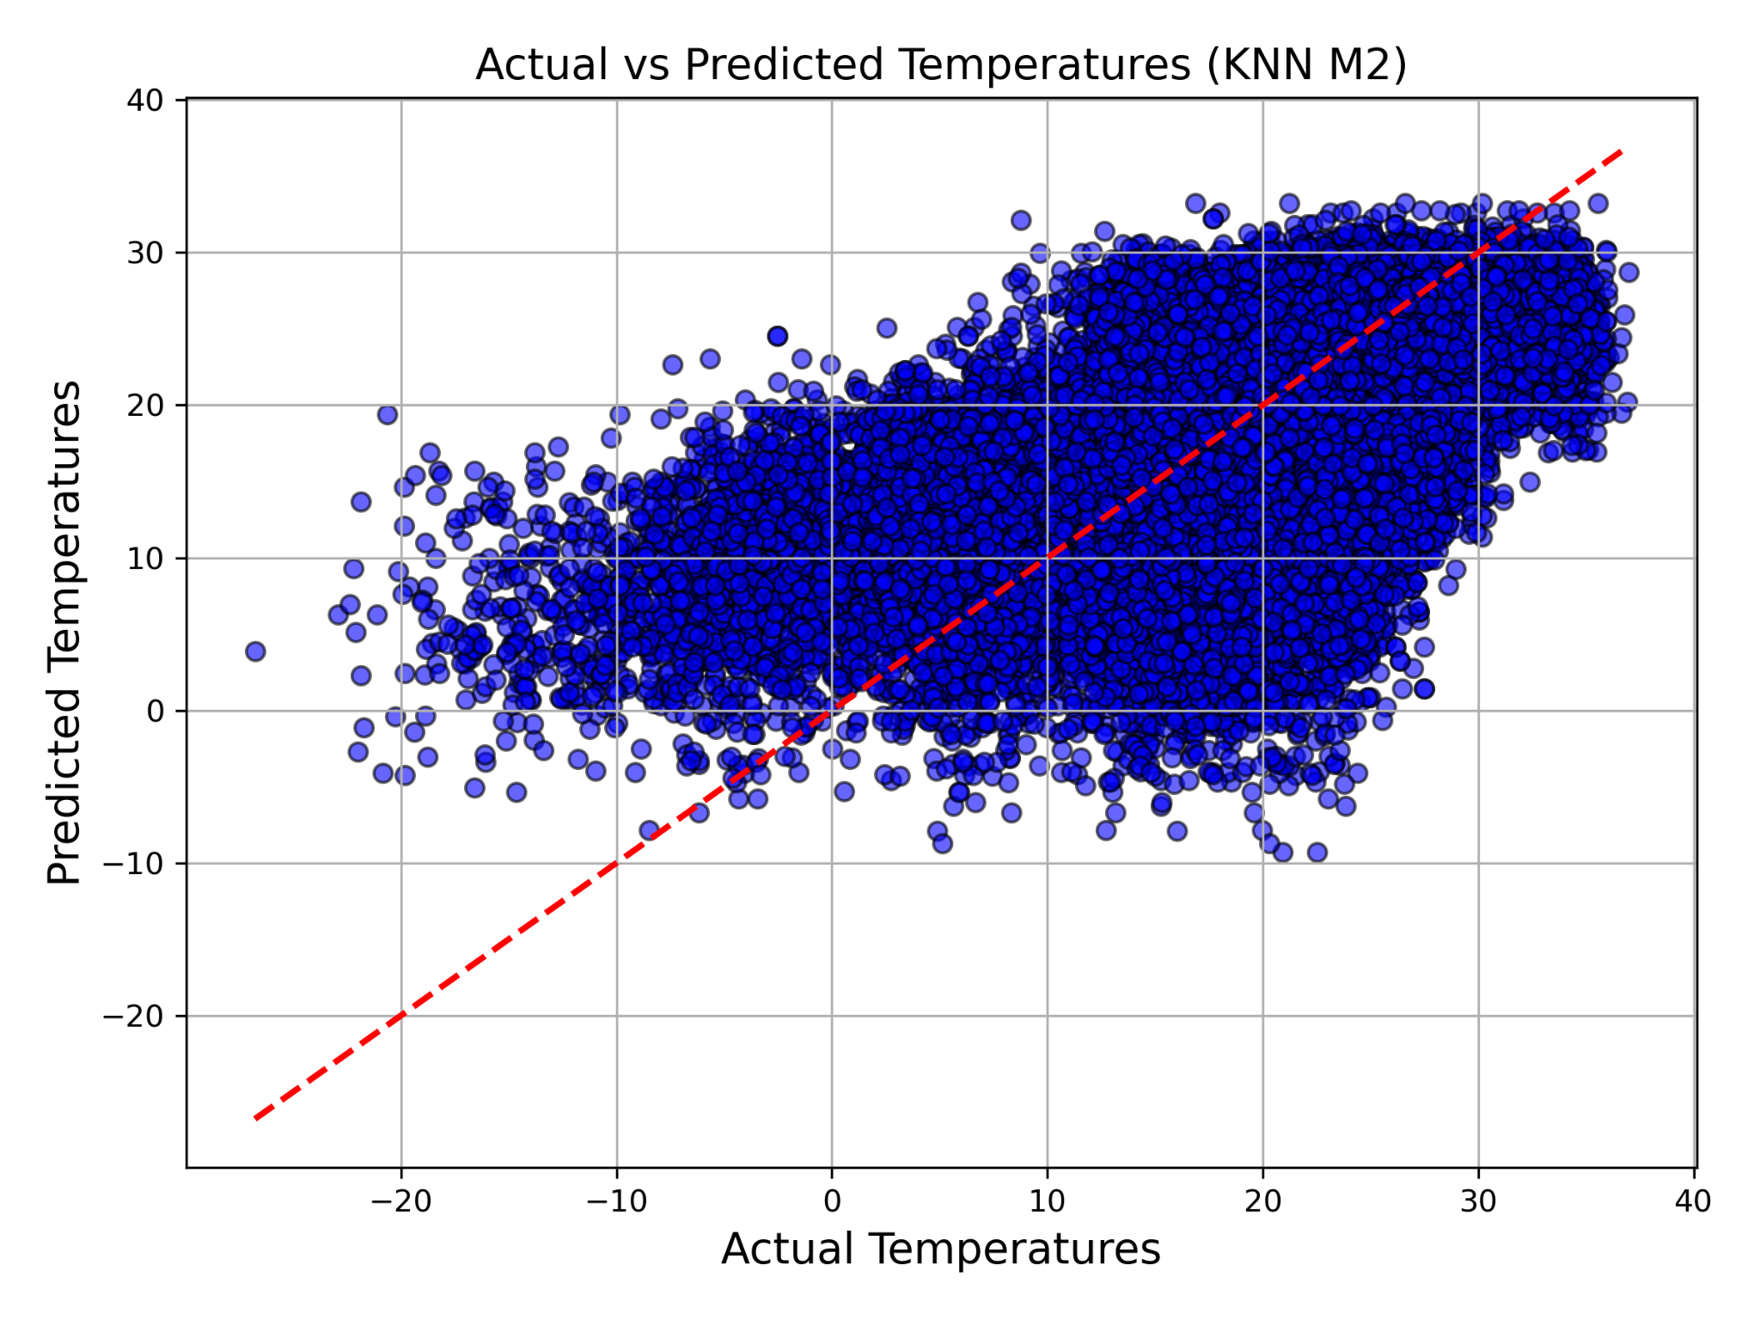
Comparison of KNN
Notes:
M2 has less features (no month)
Reduction of features led to too much accuracy loss

Slide 11
Results
Model | MAE | MSE | RMSE | R^2
Random Forest | 0.7750 | 1.3258 | 1.1514 | 0.9857
KNN (Final Features) | 1.1471 | 2.7303 | 1.6524 | 0.9705
KNN (Reduced Features) | 5.2274 | 52.9441 | 7.2763 | 0.4287
SVR (RBF Kernel) | 2.0081 | 7.6086 | 2.7584 | 0.9179
SVR (Poly Kernel) | 5.9241 | 58.0018 | 7.6159 | 0.3741
SVR (Linear Kernel) | 6.8501 | 84.9333 | 9.2159 | 0.0835
Linear Regression | 7.0842 | 79.7846 | 8.9322 | 0.1391
Notes:
Performance metrics:
Random forest preformed the best
Linear regression performed the worst still brought valuable information

Slide 12
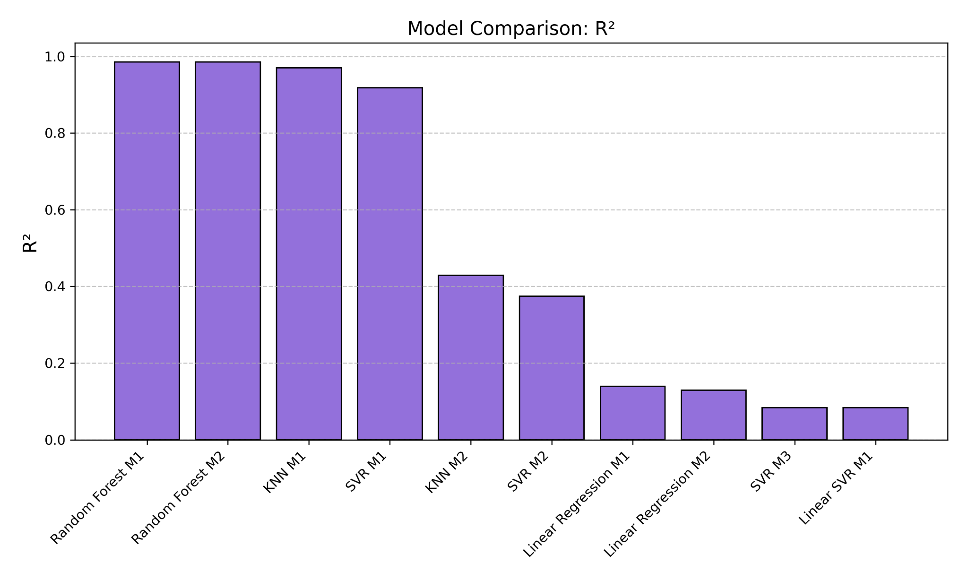
Notes:
Bar graph comparing all the models for better visualization

Slide 13
Conclusion
Machine learning models, specifically Random Forest and KNN, demonstrated exceptional capability in capturing spatial and temporal climate patterns.
Random Forest achieved the highest accuracy with an R2 score of 0.9857, highlighting its robustness and predictive power.
The results underscore the critical role of non-linear models in addressing the complexity of climate data.
Linear models like Linear Regression and SVR with a linear kernel performed poorly due to the complex nature of climate data.
Notes:
Random forest performed best with .9857 score Linear models performed poorly

Slide 14
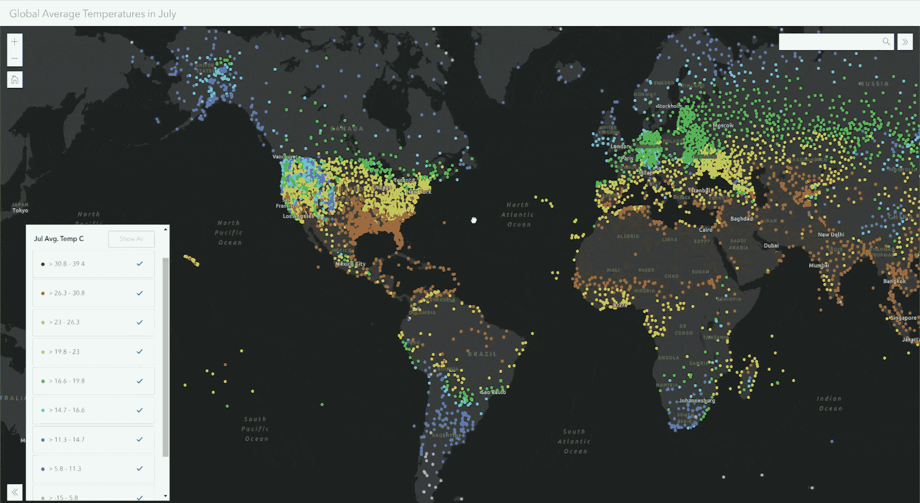
Future Work
Map integration using arcGIS
Utilize more models and merge more data for more accurate predictions
Integrate with a front end allow for users to see various metric of data from our models
Notes:
Map integrations
Add more models and merge more datasets

Slide 15

Questions

